Slide 1

LAN Chat
Chat with privacy
Mirza Iliyaz Baig : 1604-18-737-308
Mohd Afroz : 1604-18-737-091
Shaik Ashfaq Ahmed : 1604-18-737-095
Under the guidance of
- M.A. Rasheed

Slide 2
ABSTRACT
LAN chat application is one of easiest way to chat with
your friends through LAN. No internet connection is needed.
The only thing which requires is server IP address and you will
be able to connect to others members through LAN. It can help
you to talk to your friends even you both do not have internet
connection. As it is based on LAN. LAN i.e. Local area network
which connect different client to each other and also client to
main server. So we have used the same concept here we are
connecting two or more client to the server with each other
and by providing the IP address we can talk with each other.

Slide 3
On the other hand file sharing application is also
implemented where a user can upload a file on a server.
We are providing the path to the directory where we
have stored our file to the user who wants to access
particular file.

Slide 4
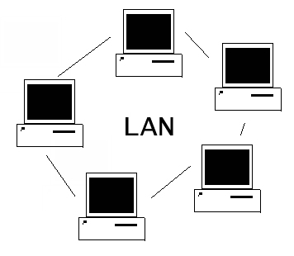
Problem Statement
The problem with the internet messaging i.e., Data loss or viewed by third party while transferring data or information, Some un-trusted staff will denial the task that given to them, take time to receive the data or information through internet.
So, the System to be developed here is a chat application in LAN. It is a client-server system where all clients are connected to the server via LAN. This chat application can also be used for group discussions. The client can only connect when the SERVER IP address is known, we use this application via LAN.

Slide 5
In case, if there is a need of transferring files to the clients, the application should provide files sharing such as the client can download and upload the files.

Slide 6
Proposed solution
To secure the data and information by sending it through LAN network.
Saves up time for data processing.
Secure connection for interaction between clients.
Speed transferring of files.

Slide 7
Project Deliverables
Chatting system module.
File sharing module.

Slide 8
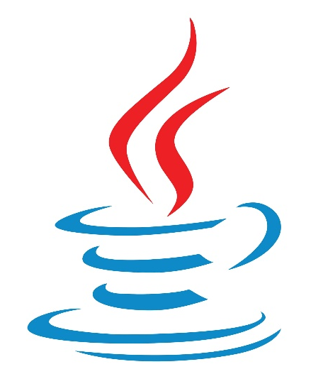
Platform Of Implementation
Java

Slide 9
Conclusion
This LAN chat and file sharing Application is developed using fully java, it meets the objectives of the system for which it has been developed.
We have tested it for 4 clients and it has worked.

Slide 10
THANK YOU

